Slide 1
Graph Traversals Algorithms
Design and Analysis of Algorithms

Slide 2
Depth-first searching
A depth-first search (DFS) explores a path all the way to a leaf before backtracking and exploring another path
For example, after searching A, then B, then D, the search backtracks and tries another path from B
Node are explored in the order A B D E H L M N I O P C F G J K Q
N will be found before J
A
B
C
D
E
F
G
H
I
J
K
L
M
N
O
P
Q

Slide 3
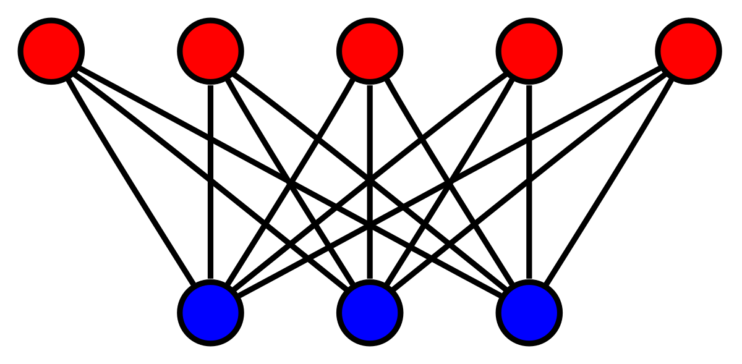
Depth First Search
Depth-first search (DFS) is an algorithm (or technique) for traversing a graph.
Detecting cycle in a graph
Path Finding
Topological Sorting
To test if a graph is bipartite
Finding Strongly Connected Components of a graph
Solving puzzles with only one solution
Bipartite Graph
Notes:
Depth-first search (DFS) is an algorithm (or technique) for traversing a graph.
Following are the problems that use DFS as a building block.
1) For a weighted graph, DFS traversal of the graph produces the minimum spanning tree and all pair shortest path tree.
2) Detecting cycle in a graph A graph has cycle if and only if we see a back edge during DFS. So we can run DFS for the graph and check for back edges. (See this for details)
3) Path Finding We can specialize the DFS algorithm to find a path between two given vertices u and z. i) Call DFS(G, u) with u as the start vertex. ii) Use a stack S to keep track of the path between the start vertex and the current vertex. iii) As soon as destination vertex z is encountered, return the path as the contents of the stack
4) Topological Sorting Topological Sorting is mainly used for scheduling jobs from the given dependencies among jobs. In computer science, applications of this type arise in instruction scheduling, ordering of formula cell evaluation when recomputing formula values in spreadsheets, logic synthesis, determining the order of compilation tasks to perform in makefiles, data serialization, and resolving symbol dependencies in linkers [2].
5) To test if a graph is bipartite We can augment either BFS or DFS when we first discover a new vertex, color it opposited its parents, and for each other edge, check it doesn’t link two vertices of the same color. The first vertex in any connected component can be red or black! See this for details.
6) Finding Strongly Connected Components of a graph A directed graph is called strongly connected if there is a path from each vertex in the graph to every other vertex. (See this for DFS based algo for finding Strongly Connected Components) 7) Solving puzzles with only one solution, such as mazes. (DFS can be adapted to find all solutions to a maze by only including nodes on the current path in the visited set.)

Slide 4
Breadth-first searching
A breadth-first search (BFS) explores nodes nearest the root before exploring nodes further away
For example, after searching A, then B, then C, the search proceeds with D, E, F, G
Node are explored in the order A B C D E F G H I J K L M N O P Q
J will be found before N
A
B
C
D
E
F
G
H
I
J
K
L
M
N
O
P
Q

Slide 5
Breadth-first search
Breadth-first search is one of the simplest algorithms for searching a graph and the archetype for many important graph algorithms.
Given a graph G = (V, E) and a distinguished source vertex s, breadth-first search systematically explores the edges of G to “discover” every vertex that is reachable from s.
It computes the distance (smallest number of edges) from s to each reachable vertex.
It also produces a “breadth-first tree” with root s that contains all reachable vertices.
For any vertex reachable from s, the simple path in the breadth-first tree from s to corresponds to a “shortest path” from s to in G, that is, a path containing the smallest number of edges.
The algorithm works on both directed and undirected graphs.

Slide 6
Breadth-first searching
Shortest Path and Minimum Spanning Tree for unweighted graph
Peer to Peer Networks
Crawlers in Search Engines
Social Networking Websites
GPS Navigation systems: Breadth First Search is used to find all neighboring locations.
Broadcasting in Network: In networks, a broadcasted packet follows Breadth First Search to reach all nodes.
In Garbage Collection
Cycle detection in undirected graph:
Notes:
1) Shortest Path and Minimum Spanning Tree for unweighted graph In an unweighted graph, the shortest path is the path with least number of edges. With Breadth First, we always reach a vertex from given source using the minimum number of edges. Also, in case of unweighted graphs, any spanning tree is Minimum Spanning Tree and we can use either Depth or Breadth first traversal for finding a spanning tree.
2) Peer to Peer Networks. In Peer to Peer Networks like BitTorrent, Breadth First Search is used to find all neighbor nodes.
3) Crawlers in Search Engines: Crawlers build index using Breadth First. The idea is to start from source page and follow all links from source and keep doing same. Depth First Traversal can also be used for crawlers, but the advantage with Breadth First Traversal is, depth or levels of the built tree can be limited.
4) Social Networking Websites: In social networks, we can find people within a given distance ‘k’ from a person using Breadth First Search till ‘k’ levels.
5) GPS Navigation systems: Breadth First Search is used to find all neighboring locations.
6) Broadcasting in Network: In networks, a broadcasted packet follows Breadth First Search to reach all nodes.
7) In Garbage Collection: Breadth First Search is used in copying garbage collection using Cheney’s algorithm. Refer this and for details. Breadth First Search is preferred over Depth First Search because of better locality of reference:
8) Cycle detection in undirected graph: In undirected graphs, either Breadth First Search or Depth First Search can be used to detect cycle. We can use BFS to detect cycle in a directed graph also,
9) Ford–Fulkerson algorithm In Ford-Fulkerson algorithm, we can either use Breadth First or Depth First Traversal to find the maximum flow. Breadth First Traversal is preferred as it reduces worst case time complexity to O(VE²).

Slide 7
Breadth-first searching
To test if a graph is Bipartite
Path Finding
Finding all nodes within one connected component.

Slide 8
Breadth-first search
Breadth-first search is so named because it expands the frontier between discovered and undiscovered vertices uniformly across the breadth of the frontier.
That is, the algorithm discovers all vertices at distance k from s before discovering any vertices at distance k + 1.

Slide 9
Breadth-first search
Distance
Distance from u to v
The number of edges in the shortest path from u to v.
The distance from s to v is 2.
r
s
t
u
v
w
x
y

Slide 10
Breadth-first search
Breadth-first search
Given a graph G = (V, E) and a source vertex s, it explores the edges of G to "discover" every reachable vertex from s.
It discovers vertices in the increasing order of distance from the source. It first discovers all vertices at distance 1, then 2, and etc.
r
s
t
u
∽
0
∽
∽
∽
∽
∽
∽
v
w
x
y

Slide 11
Breadth-first search
Breadth-first search
Given a graph G = (V, E) and a source vertex s, it explores the edges of G to "discover" every reachable vertex from s.
It discovers vertices in the increasing order of distance from the source. It first discovers all vertices at distance 1, then 2, and etc.
r
s
t
u
1
0
∽
∽
∽
1
∽
∽
v
w
x
y

Slide 12
Breadth-first search
Breadth-first search
Given a graph G = (V, E) and a source vertex s, it explores the edges of G to "discover" every reachable vertex from s.
It discovers vertices in the increasing order of distance from the source. It first discovers all vertices at distance 1, then 2, and etc.
r
s
t
u
1
0
2
∽
2
1
2
∽
v
w
x
y

Slide 13
Breadth-first search
Breadth-first search
Given a graph G = (V, E) and a source vertex s, it explores the edges of G to "discover" every reachable vertex from s.
It discovers vertices in the increasing order of distance from the source. It first discovers all vertices at distance 1, then 2, and etc.
r
s
t
u
1
0
2
3
2
1
2
3
v
w
x
y

Slide 14
Breadth-first search
Breadth-first search
It also computes
the distance of vertices from the source: d[u] = 3
the predecessor of vertices: π[u] = t
r
s
t
u
1
0
2
3
2
1
2
3
v
w
x
y

Slide 15
Breadth-first search
The predecessor subgraph of G as G_{π} = (V_{π}, E_{π}),
V_{π} = {v ∈ V: π[v] ≠ NIL} U { s}
E_{π} = {(π[v], v) : v ∈ V_{π} - {s}}.
V_{π} consists of the vertices reachable from s and, for all v ∈ V_{π and} the subgraph G_{π} contains a unique simple path from s to v that is also a shortest path from s to v in G
r
s
t
u
1
0
2
3
2
1
2
3
v
w
x
y

Slide 16
Breadth-first search
The predecessor subgraph G_{π} is a breadth-first tree.
since it is connected and |E_{π}| = |V_{π}| -1.
The edges in E_{π} are called tree edges.
r
s
t
u
1
0
2
3
2
1
2
3
v
w
x
y

Slide 17
Breadth-first search
BFS(G, s)
1 for each vertex u V [G] - {s}
2 do color[u] ← WHITE
3 d[u] ← ∞
4 π[u] ← NIL
5 color[s] ← GRAY
6 d[s] ← 0
7 π[s] ← NIL
8 Q ← Ø
9 ENQUEUE(Q, s)
10 while Q ≠ Ø
11 do u ← DEQUEUE(Q)
12 for each v ∈ Adj[u]
13 do if color[v] = WHITE
14 then color[v] ← GRAY
15 d[v] ← d[u] + 1
16 π[v] ← u
17 ENQUEUE(Q, v)
18 color[u] ← BLACK

Slide 18
Breadth-first search
r
s
t
u
∽
0
∽
∽
r
s
v
∽
∽
∽
∽
s
r
w
t
u
w
x
v
w
x
y
u
t
x
y
v
r
Q
s
w
s
t
x
0
x
t
u
x
y
y
u
x

Slide 19
Breadth-first search
r
s
t
u
r
s
v
1
0
∽
∽
s
r
w
t
u
w
x
∽
1
∽
∽
u
t
x
y
v
r
v
w
x
y
w
s
t
x
Q
w
r
x
t
u
x
y
1
1
y
u
x
white: not discovered (not entered the Q)
gray: discovered (in the Q)
black: finished (out of the Q)

Slide 20
Breadth-first search
r
s
t
u
1
0
2
∽
r
s
v
s
r
w
∽
1
2
∽
t
u
w
x
v
w
x
y
u
t
x
y
v
r
Q
r
t
x
w
s
t
x
1
2
2
t
u
x
y
x
y
u
x

Slide 21
Breadth-first search
r
s
t
u
1
0
2
∽
r
s
v
s
r
w
2
1
2
∽
t
u
w
x
v
w
x
y
u
t
x
y
v
r
Q
t
x
v
w
s
t
x
2
2
2
t
u
x
y
x
y
u
x

Slide 22
Breadth-first search
r
s
t
u
1
0
2
3
r
s
v
s
r
w
2
1
2
∽
t
u
w
x
v
w
x
y
u
t
x
y
v
r
Q
x
v
u
w
s
t
x
2
2
3
t
u
x
y
x
y
u
x

Slide 23
Breadth-first search
r
s
t
u
1
0
2
3
r
s
v
s
r
w
2
1
2
3
t
u
w
x
v
w
x
y
u
t
x
y
v
r
Q
v
u
y
w
s
t
x
2
3
3
t
u
x
y
x
y
u
x

Slide 24
Breadth-first search
r
s
t
u
1
0
2
3
r
s
v
s
r
w
2
1
2
3
t
u
w
x
v
w
x
y
u
t
x
y
v
r
Q
u
y
w
s
t
x
3
3
t
u
x
y
x
y
u
x

Slide 25
Breadth-first search
r
s
t
u
1
0
2
3
r
s
v
s
r
w
2
1
2
3
t
u
w
x
v
w
x
y
u
t
x
y
v
r
Q
y
w
s
t
x
3
t
u
x
y
x
y
u
x

Slide 26
Breadth-first search
r
s
t
u
1
0
2
3
r
s
v
s
r
w
2
1
2
3
t
u
w
x
v
w
x
y
u
t
x
y
v
r
Q
￠
w
s
t
x
3
x
t
u
x
y
y
u
x

Slide 27
Breadth-first search
BFS(G, s)
1 for each vertex u V [G] - {s}
2 do color[u] ← WHITE
3 d[u] ← ∞
4 π[u] ← NIL
5 color[s] ← GRAY
6 d[s] ← 0
7 π[s] ← NIL
8 Q ← Ø
9 ENQUEUE(Q, s)
10 while Q ≠ Ø
11 do u ← DEQUEUE(Q)
12 for each v ∈ Adj[u]
13 do if color[v] = WHITE
14 then color[v] ← GRAY
15 d[v] ← d[u] + 1
16 π[v] ← u
17 ENQUEUE(Q, v)
18 color[u] ← BLACK
O ( V )
O ( E )
O ( V +E)

Slide 28
Analysis
Running time
Initialization: Θ(V)
Exploring the graph: O(E)
An enque operation for an edge exploration.
#deque operations = #enque operations
An edge is explored at most once.
Overall: O(V + E)

Slide 29
Analysis- Initialization
After initialization, breadth-first search never whitens a vertex, and thus the test in line 13 ensures that each vertex is enqueued at most once, and hence dequeued at most once.
The operations of enqueuing and dequeuing take O(1) time, and so the total time devoted to queue operations is O(V).

Slide 30
Analysis- Exploring the graph
Because the procedure scans the adjacency list of each vertex only when the vertex is dequeued, it scans each adjacency list at most once.
Since the sum of the lengths of all the adjacency lists is Ѳ (E ), the total time spent in scanning adjacency lists is O ( E )
The overhead for initialization is O(V), and thus the total running time of the BFS procedure is O(V +E ).
Thus, breadth-first search runs in time linear in the size of the adjacency-list representation of G.

Slide 31
Content
Breadth-first search
Depth-first search

Slide 32
Depth First Search Algorithm
Depth-first search explores edges out of the most recently discovered vertex that still has unexplored edges leaving it.
Once all of ’s edges have been explored, the search “backtracks” to explore edges leaving the vertex from which was discovered.
This process continues until we have discovered all the vertices that are reachable from the original source vertex.
If any undiscovered vertices remain, then depth-first search selects one of them as a new source, and it repeats the search from that source.
The algorithm repeats this entire process until it has discovered every vertex.

Slide 33
Depth-first search
Colors of vertices
Each vertex is initially white. (not discovered)
The vertex is grayed when it is discovered.
The vertex is blackened when it is finished, that is, when its adjacency list has been examined completely.
u
v
w
x
y
z

Slide 34
Depth-first search
Timestamps
Each vertex v has two timestamps.
d[v]: discovery time (when v is grayed)
f [v]: finishing time (when v is blacken)
u
v
w
1/
2/
4/5
3/
x
y
z

Slide 35
Depth-first search
u
v
w
u
v
w
1/
1/
2/
x
y
z
x
y
z
(a)
(b)
u
v
w
u
v
w
1/
2/
1/
2/
3/
4/
3/
x
y
z
x
y
z
(c)
(d)

Slide 36
Depth-first search
u
v
w
u
v
w
1/
2/
1/
2/
4/
3/
4/5
3/
x
y
z
x
y
z
(e)
(f)
u
v
w
u
v
w
1/
2/
1/
2/7
4/5
3/6
4/5
3/6
x
y
z
x
y
z
(g)
(h)

Slide 37
Depth-first search
u
v
w
u
v
w
1/
2/7
1/8
2/7
4/5
3/6
4/5
3/6
x
y
z
x
y
z
(i)
(j)
u
v
w
u
v
w
1/8
2/7
9/
1/8
2/7
9/
4/5
3/6
4/5
3/6
x
y
z
x
y
z
(k)
(l)

Slide 38
Depth-first search
u
v
w
u
v
w
1/8
2/7
9/
1/8
2/7
9/
4/5
3/6
10/
4/5
3/6
10/
x
y
z
x
y
z
(m)
(n)
u
v
w
u
v
w
1/8
2/7
9/
1/8
2/7
9/12
4/5
3/6
10/11
4/5
3/6
10/11
x
y
z
x
y
z
(o)
(p)

Slide 39
Depth-first search
The predecessor subgraph is a depth-first forest.
u
w
v
z
y
x

Slide 40
Depth-first search
Classification of edges
Tree edges
Back edges
Forward edges
Cross edges
u
w
C
v
z
B
y
F
x

Slide 41
Depth-first search
Tree edges: Edges in the depth-first forest.
Back edges: Those edges (u, v) connecting a vertex u to an ancestor v in a depth-first tree. Self-loops are considered to be back edges.
Forward edges: Those edges (u, v) connecting a vertex u to a descendant v in a depth-first tree.
Cross edges: All other edges. They can go between vertices in the same depth-first tree, as long as one vertex is not an ancestor of the other, or they can go between vertices in different depth-first trees.

Slide 42
Depth-first search
Classification by the DFS algorithm
Each edge (u, v) can be classified by the color of the vertex v that is reached when the edge is first explored:
WHITE indicates a tree edge,
GRAY indicates a back edge, and
BLACK indicates a forward or cross edge.

Slide 43
Depth-first search (parenthesis structure)
If we represent the discovery of vertex u with a left parenthesis “ (u” and represent its finishing by a right parenthesis “u)”, then the history of discoveries and finishing makes a well-formed expression in the sense that the parentheses are properly nested.
 |  |  | u |  |  |  |  |  | w
 |  |  | v |  |  |  |  |  | z
 |  |  | y
 |  |  | x
u
w
C
v
z
B
y
F
x
1
2
3
4
5
6
7
8
9
10
11
12
(u
(v
(y
(x
x)
y)
v)
u)
(w
(z
z)
w)

Slide 44
Depth-first search
u
v
w
u
v
w
1/
2/
1/
2/
B
B
4/
3/
4/5
3/
x
y
z
x
y
z
(e)
(f)
u
v
w
u
v
w
1/
2/
1/
2/7
B
B
4/5
3/6
4/5
3/6
x
y
z
x
y
z
(g)
(h)

Slide 45
Depth-first search
u
v
w
u
v
w
1/
2/7
1/8
2/7
F
B
F
B
4/5
3/6
4/5
3/6
x
y
z
x
y
z
(i)
(j)
u
v
w
u
v
w
1/8
2/7
9/
1/8
2/7
9/
B
F
B
C
F
4/5
3/6
4/5
3/6
x
y
z
x
y
z
(k)
(l)

Slide 46
Depth-first search
u
v
w
u
v
w
1/8
2/7
9/
1/8
2/7
9/
F
B
C
F
B
C
4/5
3/6
10/
B
4/5
3/6
10/
x
y
z
x
y
z
(m)
(n)
u
v
w
u
v
w
1/8
2/7
9/
1/8
2/7
9/12
F
B
C
F
B
C
B
B
4/5
3/6
10/11
4/5
3/6
10/11
x
y
z
x
y
z
(o)
(p)

Slide 47
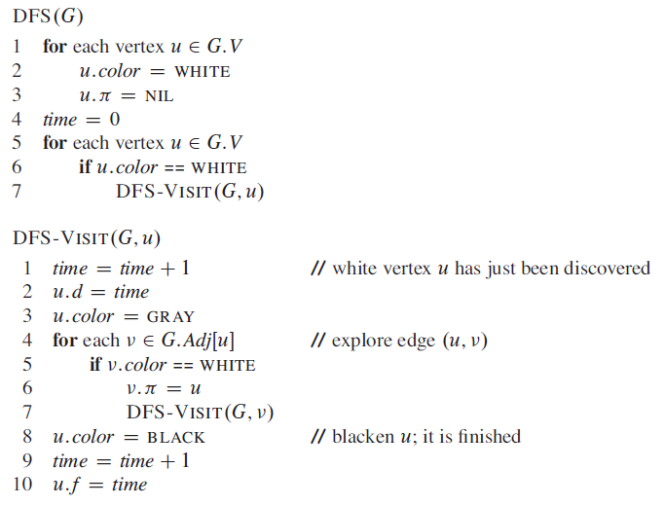
Depth-first search
Θ ( V )
Θ ( E )
Θ ( V+E )

Slide 48

Analysis
The loops on lines 1–3 and lines 5–7 of DFS take time Ѳ (V ), exclusive of the time to execute the calls to DFS-VISIT.
The procedure DFS-VISIT is called exactly once for each vertex є V , since the vertex u on which DFS-VISIT is invoked must be white and the first thing DFS-VISIT does is paint vertex u gray.
During an execution of DFS-VISIT (G, v) , the loop on lines 4–7 executes |Adj[v]| times. Since
the total cost of executing lines 4–7 of DFS-VISIT is Ѳ (E).
The running time of DFS is therefore Ѳ (V + E)

Slide 49
Applications

Slide 50
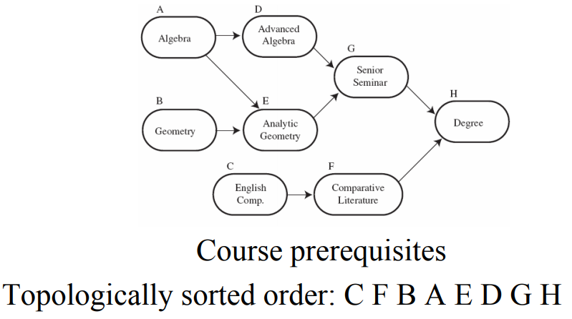
Topological Sorting

Slide 51
Topological Sorting
Problem: find a total order consistent with a partial order
Example:
Five courses has the prerequisite relation shown in the left. Find the right order to take all of them sequentially
Note: problem is solvable iff graph is dag
Notes:
The significance of topological sorting is not brought out in this whimsical example, so it is important to introduce it with a sort of disclaimer and point out the importance
of the topological sorting problem. On the other hand, it is more fun to go over this kind of example in class, because you can’t help feeling involved when your turn
of getting eaten is being deliberated!
It is a good idea to go over the solution using both algorithms and show that you get a different solution. Using alphabetical order to break ties:
dfs-based algorithm: traversal yields the components (order popped from stack):
tiger- human- fish
shrimp-plankton
sheep
wheat
reversing the order we obtain the topological sorting:
wheat sheep plankton shrimp fish human tiger
2) source removal algorithm:
plankton shrimp fish wheat sheep human tiger

Slide 52
Topological Sorting Algorithms
DFS-based algorithm:
DFS traversal: note the order with which the vertices are popped off stack (dead end)
Reverse order solves topological sorting
Back edges encountered?→ NOT a DAG!
Source removal algorithm
Repeatedly identify and remove a source vertex, ie, a vertex that has no incoming edges
Both Θ(V+E) using adjacency linked lists

Slide 53
An Example (Topological Sort)

Slide 54
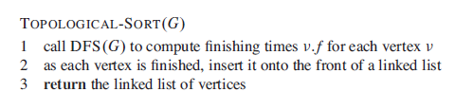
Topological Sort

Slide 55
Cycle
A path (v₀, v₁, v₂, . . . , v_{k} ) forms a cycle if v₀ = v_{k} and all edges on the path are distinct
A cycle is simple if v₁, v₂, . . . , v_{k} are distinct
A graph with no cycles is acyclic
A
S
C
M
H
B
P _{T}
L
N
(T, S, H, T) is a simple cycle
(A, C, L, P, H, A) is a simple cycle

Slide 56
An Application of DFS: Cycle Finding
Question
Given an undirected graph G , how to determine whether or not G
contains a cycle?
Lemma
G is acyclic if and only if a DFS of G yields no back edges.
Proof.
⇒: Suppose that there is a back edge (u, v ). Then, vertex v is an ancestor (excluding predecessor) of u in the DFS trees. There is thus a path from v to u in G , and the back edge (u, v ) completes a cycle.
⇐: If there is no back edge, then since an edge in an undirected graph is either a tree edge or a back edge, there are only tree edges, implying that the graph is a forest, and hence is acyclic.
Depth-First Search
14 / 15

Slide 57
Cycle Finding
Visit(u)
Cycle(G)
color[u] = GRAY;
foreach v in Adj(u) do
//consider (u, v )
if color[v] = WHITE then
// v unvisited
pred[v] = u;
Visit(v); //visit v
else if v != pred[u] then
//back edge detected output “Cycle found!”; exit; //terminate
end
end
color[u] = BLACK;
foreach u in V do color[u] = WHITE; pred[u] = NULL;
end
foreach u in V do
if color[u] = WHITE then
Visit(u);
end
end
output “No Cycle”;
Running time: O(V )
only traverse tree edges, until the first back edge is found at most V − 1 tree edges
Depth-First Search
15 / 15

Slide 58
Reference
Introduction to Algorithms
Chapter # 22
Thomas H. Cormen

